Slide 1
Vote from Abroad Basic Training
Saturday, July 11, 2020
Democrats Abroad China

Slide 2
Agenda
START TIME | TIME ALLOCATED | ITEM
10:05 | 3 minutes | Welcome & Housekeeping
10:08 | 5 minutes | Overview
10:13 | 15 minutes | Request Ballot
10:28 | 5 minutes | Receive & Return Ballot
10:33 | 5 minutes | Volunteer Opportunities
10:38 | 2 minutes | Wrap Up & Final Questions

Slide 3
Who is eligible to vote from abroad?
U.S. citizens living abroad
At least 18 years old by the date of the election
Eligible to register to vote in your state*
* You retain the right to vote in the state where you last lived, no matter how long it has been since you lived there
** For US citizens who have never resided in the US, you may be able to vote according to where your US citizen parent last lived — this varies by state.

Slide 4
Overseas absentee voters need to:
Request Ballot
Receive Ballot
Return Ballot
PHASE 1: “Get Registered & Ready to Vote” From Jan 1, 2020
PHASE 2: Did you get your ballot? Sept 19, 2020
PHASE 3: Bank those ballots
From Oct 1, 2020 until Nov. 3

Slide 5
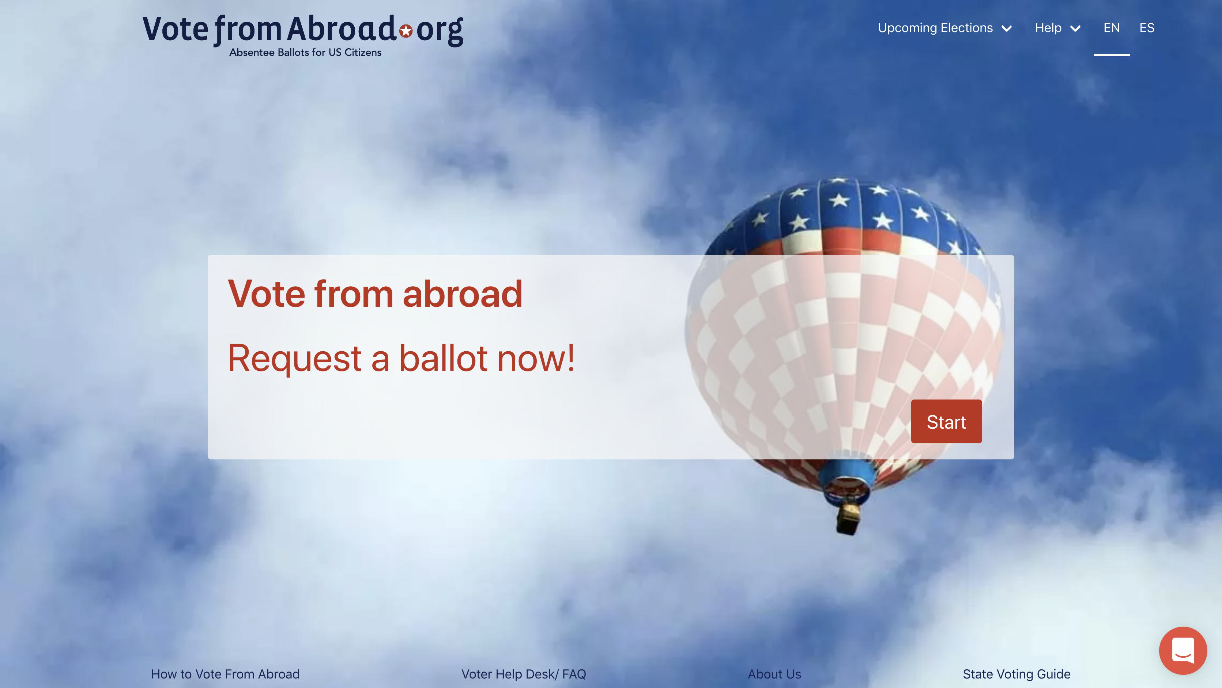

Slide 6
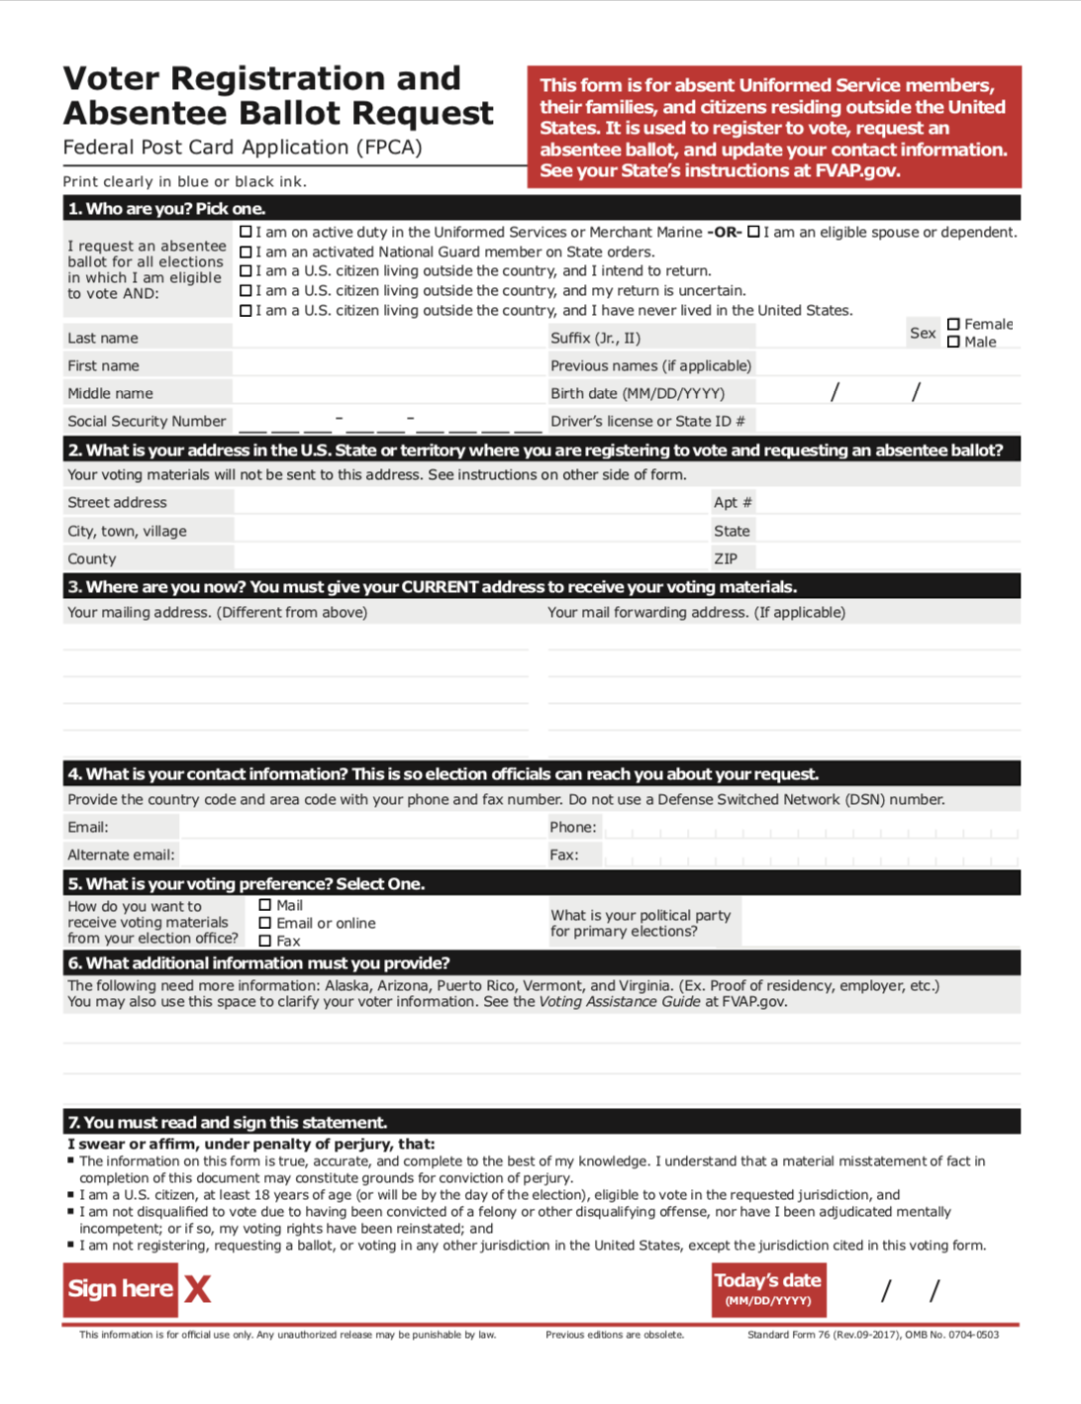
Military and Civilian Overseas Voters use a one page form to request a ballot every year – the FPCA (Federal Post Card Application)
Serves to register voters (if needed)
Serves as a request for ballots for all elections for that calendar year (primaries, special elections, general elections.)
Grants you status as a UOCAVA Voter
UOCAVA – Uniformed and Overseas Citizens Absentee Voting Act (1986); HAVA – Help America Vote Act (2002); MOVE – Military Overseas Voter Empowerment Act (2010)

Slide 7
Federal Protections for UOCAVA Voters
Right to vote in federal elections (President, U.S. Senate, and U.S. House of Representatives)
May also be allowed to vote state and local elections – varies by state
Ballot sent by 45 days in advance of the election
Ballot sent by email or online – if voter requests
Overseas absentee ballots are counted
Can use FWAB – “Back up Ballot”
Source: www.fvap.gov

Slide 8
Federal Voting Assistance Program (FVAP.gov)
Support UOCAVA voters – military and civilian
Official forms including the FPCA and printable envelope templates
Free email-to-fax service
Additional Voter Assistance Officer training
Source: www.fvap.gov

Slide 9
Am I registered to vote?
Was my FPCA processed?
Was my ballot sent to me?
Was my voted ballot received?
Find your LEO at link by state abbreviation: votefromabroad.org/states/MI

Slide 10
Local Elections Officials (LEOs)
Responsible for all voters in their district
Increased burden as demand for absentee and mail-in ballots increases with COVID-19
Work with election administration and poll workers
Often small offices
Often very responsive

Slide 11
Agenda
START TIME | TIME ALLOCATED | ITEM
10:05 | 3 minutes | Welcome & Housekeeping
10:08 | 5 minutes | Overview
10:13 | 15 minutes | Request Ballot
10:28 | 5 minutes | Receive & Return Ballot
10:33 | 5 minutes | Volunteer Opportunities
10:38 | 2 minutes | Wrap Up & Final Questions

Slide 12
Can I submit my ballot request online? Maybe!
Request Ballot
Receive Ballot
Return Ballot
Email or online FPCA request varies by state, some allow fax return. All states allow mail return. Conditions and deadlines vary by state.
PHASE 1: “Get Registered & Ready to Vote” From Jan 1, 2020
PHASE 2: Did you get your ballot? Sept 19, 2020
PHASE 3: Bank those ballots
From Oct 1, 2020 until Nov. 3

Slide 13
Easiest Way to Request Ballot!
FPCA
Federal Post Card Application (FPCA)

Slide 14
Complete in 5 steps!
FPCA
Your Information
Voting Information
Identification
Review
Sign and Submit

Slide 15
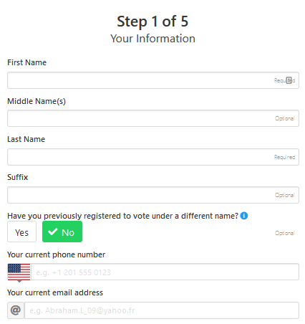
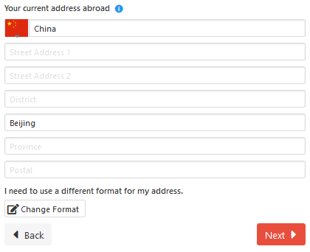
1. Your Info
Current address in China should be typed with alpha characters. Do not write with Chinese characters.
Postal codes in China can be looked up here: www.ip138.com/post/ (scroll down)
Your full China address is for informational purposes and required even though it (probably) cannot be used in this format to send a ballot to you in China.
汉字
www.ip138.com/post/

Slide 16
FAQ #13
What state do I vote in?
Your voting address is the last place you lived in the U.S.
It doesn’t matter if you have any existing relationship to this address. It doesn’t matter:
who owns the property now
even if it no longer exists as a residence
whether you were registered to vote before you left
whether you intend to return to that state
how long you have lived abroad
Source: www.votefromabroad.org/faqs/13/

Slide 17
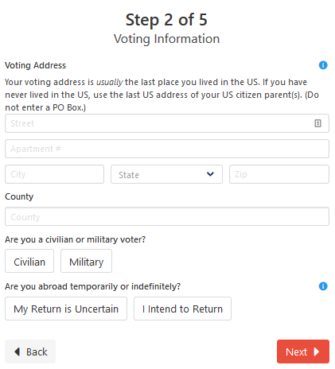
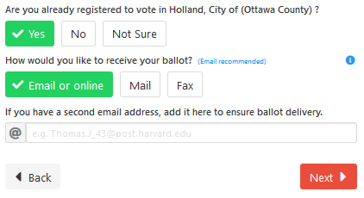
2. Voting Info
Your voting address, including country and voting jurisdiction (drop-down) – can cause the most problems for voters. (see next slide)
Are you abroad temporarily or indefinitely?
Recommend: Email or online
Notes:
Voters may choose I Intend to Return if they intend to return to the state in which they are registering to vote. An "intention" is sufficient, you don’t need to have a fixed date of return or firm plans. Registering as Intend to Return should make you eligible to vote in state and local races. However, it may also make you liable for state income taxes (if applicable in your state).
Voters may choose My Return is Uncertain if they do not have a current intention to return to the state in which they are registering to vote. Voters are entitled to receive a ballot for federal offices and may, depending on their state, also receive a ballot for state and local offices.

Slide 18
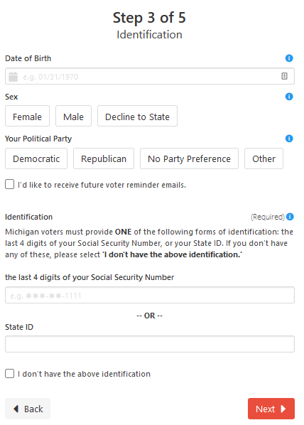
3. Identification
Sex - Most states do not require gender information, but a few, like ID and SC, still do. If you decline to state a gender and your state requires it, your state must let you know that you need to fill in the missing information.
Last 4 digits of SSN (a few states ask for full SSN) or State ID, if you have them. Otherwise, select 'I don't have the above identification

Slide 19
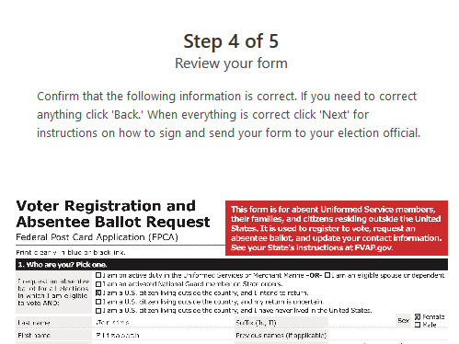
4. Review

Slide 20
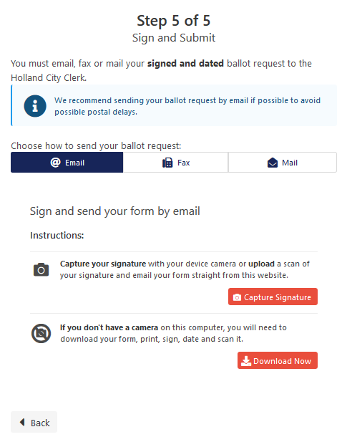
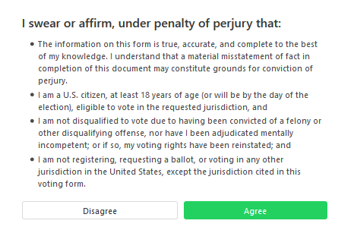
5. Sign and Submit
Capture Signature

Slide 21
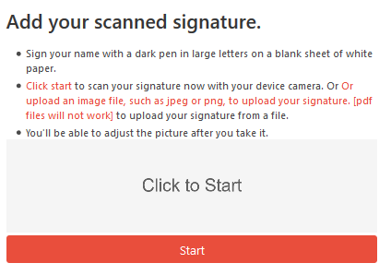
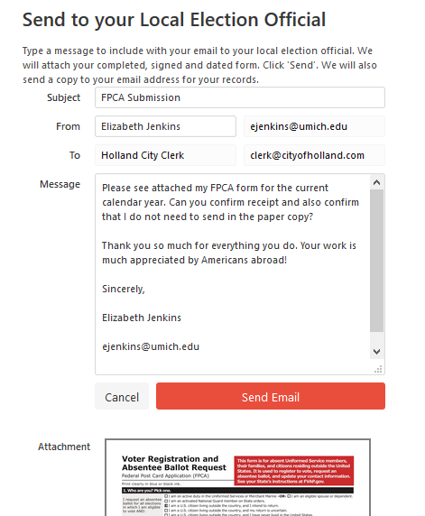
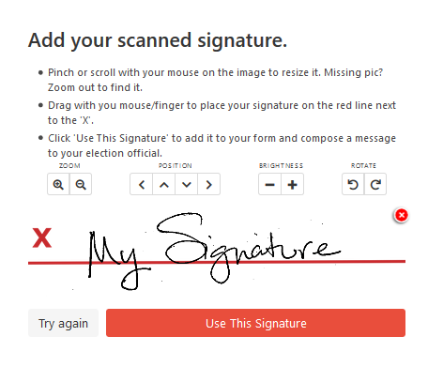
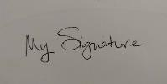
Click start to scan with device.
OR
Take a photo and upload.

Slide 22
Sign, Submit, & Verify Receipt
Most states let you sign and submit on VFA website. Or you may be directed to…
print and sign, then scan and email to your LEO (California)
print and sign, then scan and use an email-to-fax service to FAX to your LEO
print and sign, then mail by postal mail to your LEO
Verify with your LEO that your application was received and ask if it has been processed. They may need additional information or ask you to resubmit.

Slide 23
Follow Up with Your LEO
Find LEO contact information on votefromabroad.org/states
Email or call your LEO.
May be able to confirm online for status of voter registration, absentee ballot application received, and voted ballot received.
If you have problems, please alert help@votefromabroad.org so we can mobilize our voter protection team.

Slide 24
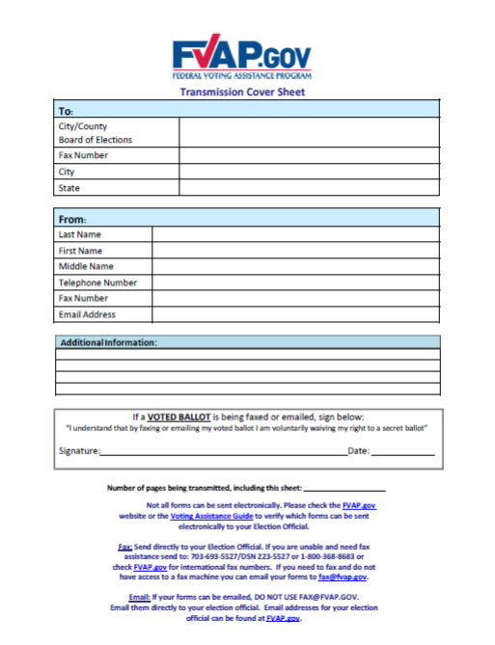
Free DoD Fax Service
Free to use for overseas citizens.
Email your FPCA or ballot with the required coversheet to fax@fvap.gov and it will be faxed to your your LEO.
Not guaranteed to be faxed immediately.
Not guaranteed to be faxed by the deadline.
Recommend you verify receipt with your LEO.
Coversheet required: www.fvap.gov/uploads/FVAP/Forms/TransmissionCoversheet.pdf
Notes:
People should not wait until the last minute! Getting their documents into the DoD is not the same as meeting the deadline--it must still get to their state election office. And the DoD office is notorious for getting backed up. If it's close to the deadline, they could look at using an email to fax app (search for “fax app for Android/iPhone")

Slide 25
Postal Mail
Regular Mail – China Post
Express Mail – DHL
Diplomatic Pouch from U.S. Consulate or Embassy
Free
No guarantee for mailing time
Can request a tracking number
Must conform to USPS rules, including U.S. postage and any size restrictions:
Postage paid template is available at: www.fvap.gov/uploads/FVAP/Forms/fpca_envelope.pdf (US #10 size) www.fvap.gov/uploads/FVAP/Forms/fpca_envelopeC4.pdf (C4)

Slide 26
Agenda
START TIME | TIME ALLOCATED | ITEM
10:05 | 3 minutes | Welcome & Housekeeping
10:08 | 5 minutes | Overview
10:13 | 15 minutes | Request Ballot
10:28 | 5 minutes | Receive & Return Ballot
10:33 | 5 minutes | Volunteer Opportunities
10:38 | 2 minutes | Wrap Up & Final Questions

Slide 27
Can I receive my ballot by email or online? YES!
Receive ballot by email or online at least 45 days before the election.
For November 3, 2020 General Election, receive yours by September 19, 2020.
Mark your calendar and check your spam folder and secondary inboxes!
Request Ballot
Receive Ballot
Return Ballot
PHASE 1: “Get Registered & Ready to Vote” From Jan 1, 2020
PHASE 2: Did you get your ballot? Sept 19, 2020
PHASE 3: Bank those ballots
From Oct 1, 2020 until Nov. 3

Slide 28
Can I return my voted ballot by email or online? MAYBE!
Request Ballot
Receive Ballot
Return Ballot
Some states allow you to return your ballot electronically, others require fax or mail.
PHASE 1: “Get Registered & Ready to Vote” From Jan 1, 2020
PHASE 2: Did you get your ballot? Sept 19, 2020
PHASE 3: Bank those ballots
From Oct 1, 2020 until Nov. 3

Slide 29
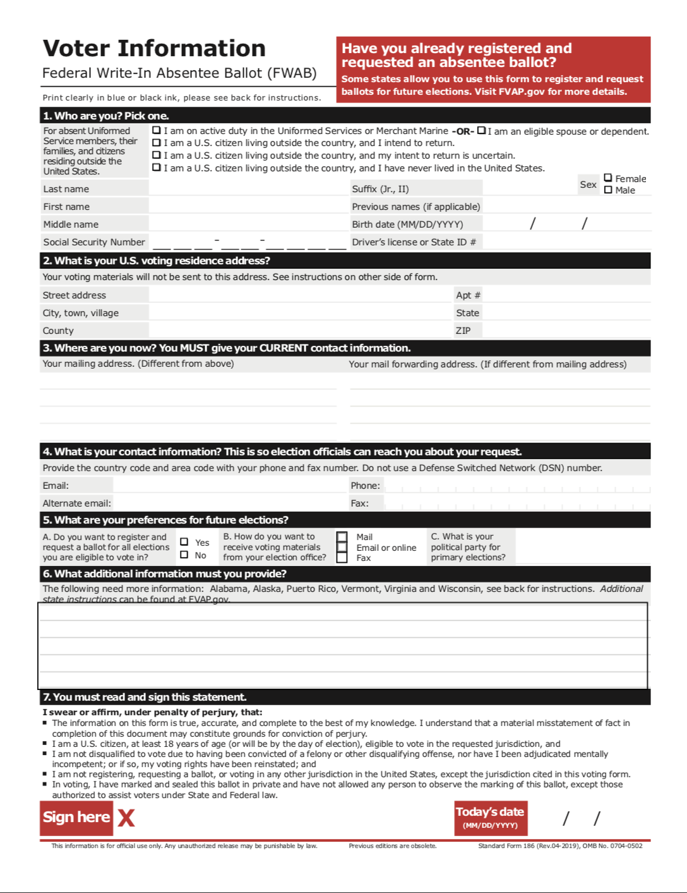
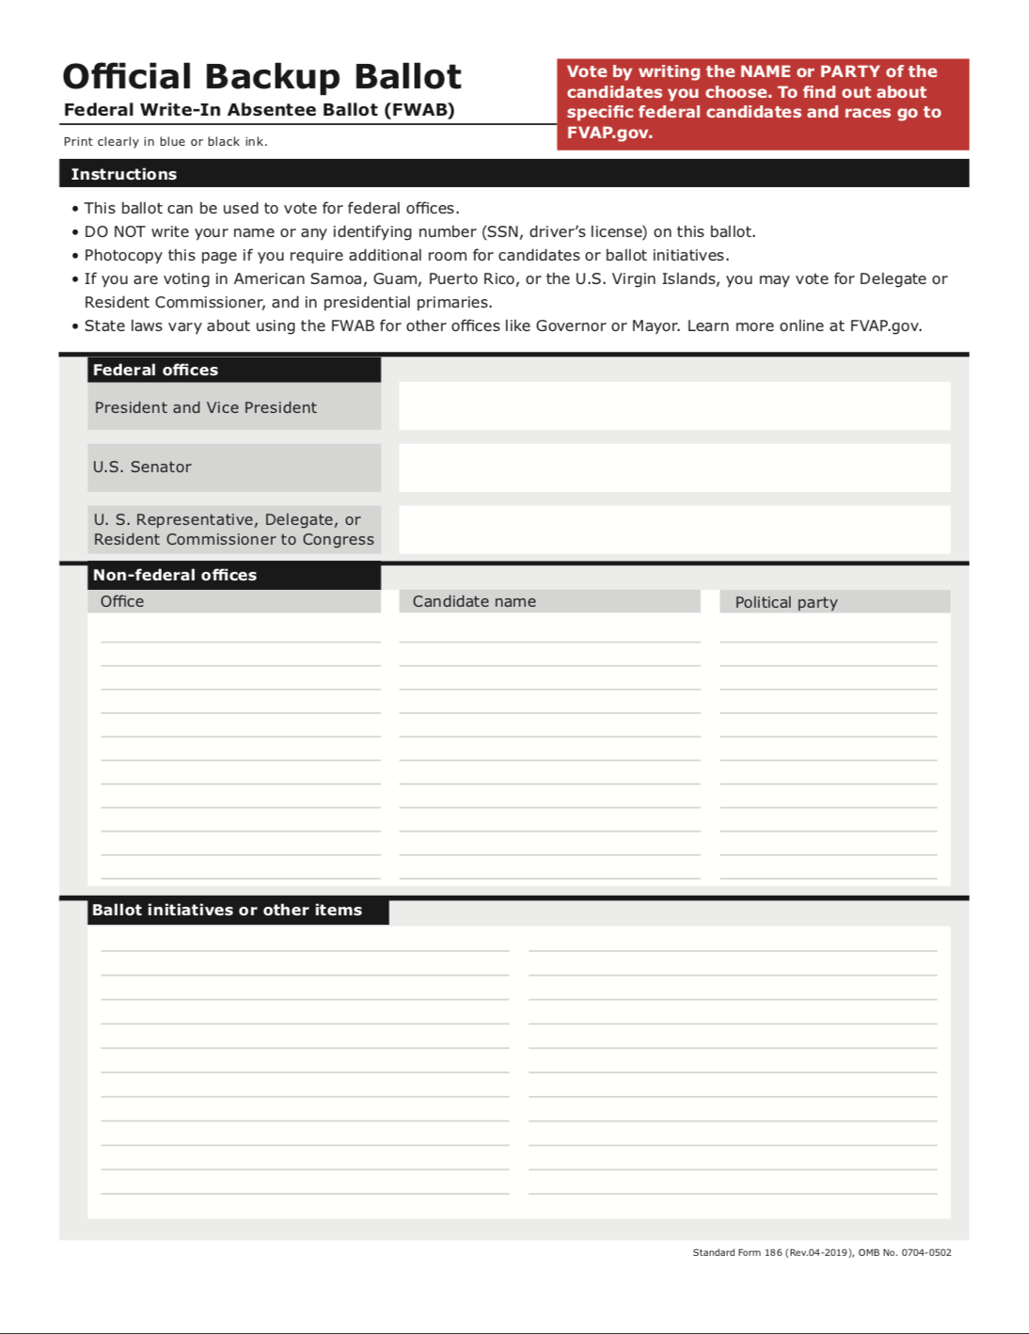
Federal Write-In Absentee Ballot (FWAB)
For UOCAVA voters who submitted FPCA only
If you have not received your official ballot by 45 days before the election, this is your back-up ballot.
If you receive your state ballot afterwards, you are supposed to vote that too – they will only count the state ballot
Same state rules for sending in your official ballot (deadline and method – email/fax/mail)

Slide 30
Agenda
START TIME | TIME ALLOCATED | ITEM
10:05 | 3 minutes | Welcome & Housekeeping
10:08 | 5 minutes | Overview
10:13 | 15 minutes | Request Ballot
10:28 | 5 minutes | Receive & Return Ballot
10:33 | 5 minutes | Volunteer Opportunities
10:38 | 2 minutes | Wrap Up & Final Questions

Slide 31
Voter Help
WeChat: VoteFromAbroad General DA China information and Voter Assistance
Email: help@votefromabroad.org
Global VFA Help Desk

Slide 32
Join the Great American Turnout 2020!
Voting Champion Toolkit
bit.ly/voting-champion
Your Friends
VFA Social Media
Step-by-Step Guides

Slide 33
Volunteer with Vote From Abroad
Events around China.
U.S. citizens only.
Mostly organized by Democrats Abroad members.
Events are non-partisan.
Contact WeChat:
VoteFromAbroad
Ask for WeChat Group:
DA China Vote From Abroad

Slide 34
Volunteer with Democrats Abroad China
Democrats Abroad members only.
Call and texts to members with info about voting.
Software is CallHub
WeChat ID:
DemocratsAbroad
Ask for WeChat Group:
DA China Call & SMS Team
democratsabroad.org/gotv_phonebanking
info-china@democratsabroad.org

Slide 35
Volunteer with Democrats Abroad
Global GOTV Team
Answer questions submitted to help@votefromabroad.org
Ticket system with volunteers all over the world.
Templates for common issues.
Helps identify voter protection issues.
Heidi Burch & Eileen Weinberg: gotv@democratsabroad.org

Slide 36
Volunteer with Democrats Abroad
Global Voter Protection Team
Helping to protect the USPS.
Expanding unrestricted ballot return options via email attachment and web portal for Americans overseas.
Advocating for vote by mail and safe, early in-person voting for Americans at home.
Keeping our members aware of changing issues impacting their rights and voting access.
Maya Buchanan: voterprotection@democratsabroad.org

Slide 37
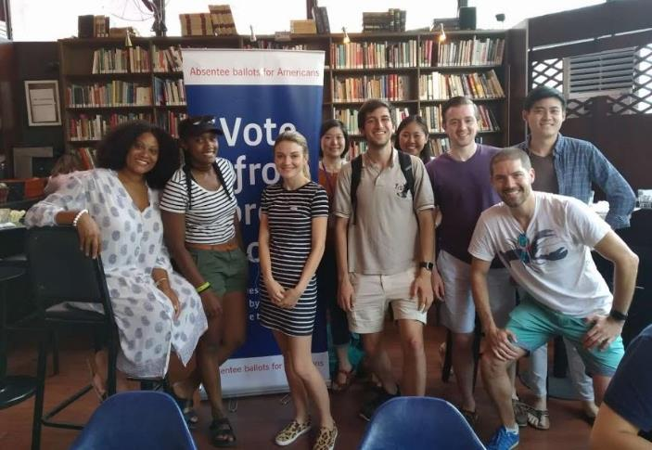
Thank you! More Questions?
VOTER HELP
China - WeChat: VoteFromAbroad
Global - help@votefromabroad.org
VOLUNTEER
China - WeChat: DemocratsAbroad
or info-china@democratsabroad.org
Global - gotv@democratsabroad.org or voterprotection@democratsabroad.org

