Slide 1
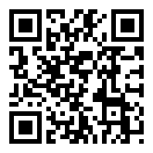
Red White &
VOTE
BLUE
Labor Day Weekend Meetup
CONNECT WITH OTHER DEMS
ONSITE VOTER SUPPORT
HELP WITH VOTER OUTREACH
MEET WOMEN’S, YOUTH, AND PROGRESSIVE CAUCUSES
2:00 – 4:00 pm
Saturday, September 1, 2018
@Beijing Bookworm (Sanlitun)

Slide 2
Red White &
VOTE
BLUE
Labor Day Weekend Meetup

