Slide 1
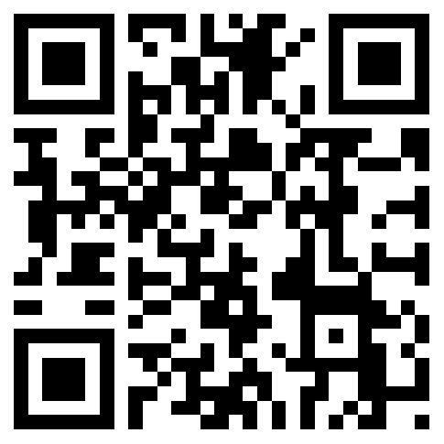
READY SET
GO
VOTE
FROM ABROAD
Free Workshop on
Absentee Voting
for Americans
Sat, Aug 25
2:30-3:00pm
Beijing Bookworm
3-5pm drop-in for voter assistance
WORKSHOP
REGISTRATION
Additional Workshop Dates
Sept 1  Sept 8  Sept 15  Sept 22  Sept 29

