Slide 1
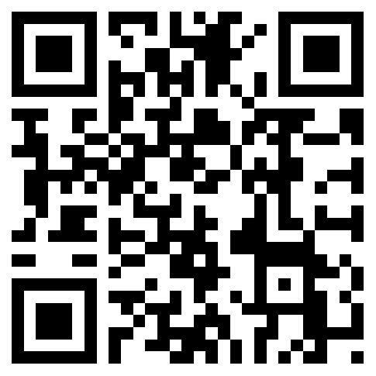
READY SET
GO
VOTE
FROM ABROAD
Free Workshop on
Absentee Voting
for Americans
2:30-3pm on Saturdays at the Bookworm
Aug 25  Sept 1  Sept 8  Sept 15
Sept 22  Sept 29  Oct 6  Oct 13
Extended hours for voter assistance: 3-5pm.
WORKSHOP REGISTRATION REQUESTED
Limit 10 participants per session.
(Drop-ins are welcome during the
extended hours for voter assistance 3-5pm.)

