Slide 1
Communications Templates Deck
Democrats Abroad China
Updated: Dec 11, 2019

Slide 2
DACN Comms Structure
The DA Comms Structure will be leveraging Point People in our various Caucuses & Regions to help ensure that events/communications are appropriately branded “Democrats Abroad” and that members across Caucuses & Locations have a clear idea of what’s going on for all of China.
Is this the Structure for Caucus &/or Region leadership teams?
Will the Comms Director be in charge of events for Caucuses or Regions?
Can the Comms Director deny a Caucus or Region from holding an event?
NO!
The DACN Comms Director does not decide how Caucus & Regions structure themselves.
The only thing the DACN Comms Director is concerned with is who to contact/receive events & communications proposals from.
NO!
The DACN Comms Director’s role is facilitator of the events Caucuses & Regions decide on their own.
Caucuses & Regions are responsible for turning in the appropriate forms to the DACN Comms Director in order to get events officially sanctioned by DACN.
NO!
The DACN Comms Director can deny officially sanctioning it as a DACN event, but Caucuses & Regions have ultimate responsibility over the events they choose to hold.
But the DACN Comms Director must explain why an event shouldn’t be sanctioned to the ExComm, who can reconsider.

Slide 3
What does the DA Comms Structure Do?
Streamline tasks required for DA to properly market activities, actions & other news
Give some guidelines to optimize activities, actions & other news for the DA community
Create an updatable list of point people so DA Comms Lead knows who owns giving the right details
Create an updatable list of volunteers who can help us get things done

Slide 4
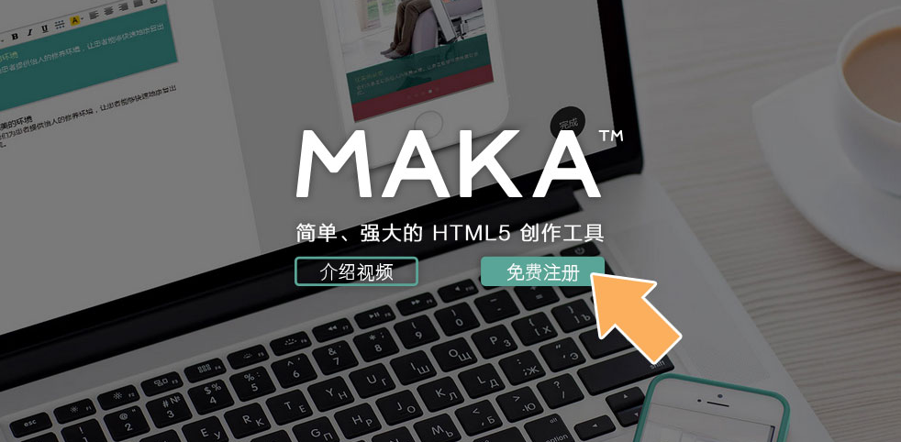
Like Graphic Design? Help us out!
Join our Canva Group if you like to design posters or social feed images!
Message Elaine with your canva.com login email address to get access to the group resources.
(Canva is freemium, we are doing everything on the free account for now)
If you can read Chinese and would be interested in creating WeChat-sharable H5 pages, check out MAKA.IM
Not necessary for the majority of the events but could be useful for sharing information on WeChat.
URL shortener that works in China (?)
https://cutit.org/
Easy web color picker (for finding the right HEX values):
https://imagecolorpicker.com/

Slide 5
Colors & Logos

Slide 7
Colors
HTML code: | #27275B | HTML code: | #8292CC | HTML code: | #BD262D
RGB code: | R: 39 G: 39 B: 91 | RGB code: | R: 130 G: 146 B: 204 | RGB code: | R: 189 G: 38 B: 45

Slide 8
Events
Templates, Best Practices, Next Steps

Slide 9
Want to host an event?
Event Form
Name of Event
Caucus | All events should be either: - Election-related (USA or DA) - Led by a specific Caucus (or co-led by Caucuses)
Date & Time | MM/DD – XX:XX to XX:XX
Fees or Deals? | Please enter any entrance admission fees required or drink/food deals on offer
Location Address | China-based address, only English needed Livestream/Webex links
Event Copy | What are we doing? Get together? Movie Screening? Phonebanking? Mailing? Why? Current events hook? Everyone needs to know something? Just for funsies?
Materials Requests | Do you need a banner? Postcards? Flyers?
Main Point Person | Name/WeChat ID (won’t be published) The person who Elaine will be bothering for photos & recaps after the event
Step 1:
Ask a DA Comms member if it works for the calendar
Step 2:
Fill out the form to the right
Step 3:
Get the form edited & approved by the DA Comms Director: Elaine Chow
It’ll be posted to the following for you to share out:
The www.democratsabroad.org website

Slide 10
Pre-Event Checklist (for Comms purposes)
Did you tell Comms (Elaine) that this event is happening?
Did you give Comms (Elaine) this information:
WHO IS LEADING THIS EVENT: ________________________
WHO SHALL MAKE THE POSTER (Elaine / Yourself)
VENUE & ADDRESS (+ does the logo need to be on poster?)
DATE & TIME
WHY THIS EVENT?
Community building (caucus/region): _______________
Database Request needed for region?
Information to be shared: ________________________
Viewing party of show/debate:___________________
Donation drive: ________________________________
Any other special hook: __________________________
WHAT IS HAPPENING AT THE EVENT?
Speech/Presentation by: _________________________
Any deals for dinner/drinks: ______________________
Any planned activities (raffle, bingo, postcards): _____________________________________________
Any costs to attendees: __________________________
Notes:
Have an American friend who might be interested in DA? Ask them to join us. We will start each event with a short intro to who we are and what we do.

Slide 11
For event organization purposes
Confirm this with the venue:
Confirm you have these:
Space (where in venue is it?) ______________________
Internet & VPN
Projector, HDMI cables
Sound
File for viewing (either streaming link or actual file)
PPT for introducing DA China
A DA sign/poster of some sort
QR code to scan for ppl to join
QR code to scan for ppl to donate
Any paper materials needed
Ie bingo sheets, brainstorm worksheets, postcards etc.

Slide 12
During Event: Best Practice Timeline
>10 min prior
Event Start
<10 min after
During Event
10 min > End
End of Event
< 2 days after
Organizers arrive for set up
Organizer does quick introduction of Democrats Abroad China (ppt available)
Take a group picture with everyone there holding up a DA sign (make sure picture is not blurry, try to take both vertical and horizontal)
Take pictures throughout the event (make sure people are in groups, doing things, not looking bored or distracted)
Thank everyone for coming, remind them to join WeChat groups and/or donate
One last group photo if possible!
Send photos and event summary write up (around 1 paragraph please!) to Elaine

Slide 13
Poster Template
Size: Insta Vertical Poster + Facebook Ad
1080px x 1350px
1) RSVP to DemocratsAbroad.org
2) Info: WHAT & WHY DEALS & ENTICEMENTS
3) Event Timing/Location

Slide 14
Event Timeline & Best Practices
4-6 weeks
before
3-4 weeks
before
2 weeks
before
≤1 week after
Submit Event Form Begin reaching out to venues for the event (ask Comms for reference materials if venue is a first-time host).
Submit materials/poster creation requests.
Submit database request if needed (ie – first event in XX City, need more help notifying DA members not in WeChat Groups)
Social Poster Created
GIVE CONTENT to COMMS to be inputted on DA website/ Facebook
**Comms will give you a QR Code for your flyer
Submitted to relevant China listings websites:
That’s
TimeOUT
The Beijinger
Shanghaiist
WeChat Reminders
Promote in WeChat to the relevant groups:
**Tick FULL IMAGE for flyer on WeChat
2 weeks before
1 week before (+ on Insta)
2 days before Day of event
IT: Figure out how the venue can support with VPN, Sound, Projector. HDMI Connection
File for Viewing: Either streaming off of Youtube, or look out for link to downloadable file via Leadership Mailing List
THE EVENT HAPPENS!
Take at least one large group pic
Ideally have 4-5 quality pics to choose from, with signs/ DA memorabilia
PLEASE DON’T SEND: 1. Pics w just one person (unless they are a speaker)
2. Pics where people look bored or distracted
3. Pics that are out of focus
Event Summary
Given to Comms Director
A GOOD SUMMARY:
What was the event for
What was accomplished
Thanks to everybody!
Link to more info
Will be posted to the relevant channels

Slide 15
Social Posts
Templates, Best Practices, Next Steps

Slide 16
FB/IG Posts
Why:
Timing considerations:
Facebook copy:
Ideally 40-80 characters
Link
Instagram copy:
135 – 150 characters
Up to five unique hashtags
I’ll put on the others:
#dachina #democratsabroad #demsabroad #expatlife #americanexpats #americansinchina #dacn #votefromabroad #voteblue
Have an image that’s great for the @democratsabroadchina Instagram?
@ Elaine in the Comms Chat and send the following >>

Slide 17
Defining our Content Pillars
Content Pillars | Political Action | DemAbroad | Community | ”Fun”gagement
Content Examples | Register to Vote reminders Primary/Election reminders Issue Activism | Events: Register to Vote Drives DA Events Schedule Posts on our members at Int’l DA events Instructionals (How Tos/Tiny Actions) | Events: Socials Leadership interviews DemAbroad member highlights Why we matter Book Club Report | News reposts Meme reposts This Day in US History
Objective | Get people registered, get them active & voting | Establish our legitimacy, show our ability to make change | Put ourselves front of mind, establish our community ties | Put ourselves front of mind, Engagement in downtimes
Key Message | Your Vote Matters. We can help you vote | Democrats Abroad is the 51st State, YOU are represented | DA China is a great group to be a part of, politically & socially | DA China can keep you informed in a fun way!
Audience | All Americans | Politically active | On the fence | All Americans
Content Portion* | 30% | 15% | 30% | 25%
Content Format | Infographics/HQ Visuals/Posts | HQ Vis/Galleries | Video/Visuals/Posts | Visuals/Posts

Slide 18
Square Frame Pic
Easy creation of Square Frame Pictures
For imgs on Instagram, WeChat Moments
Click on icon inside frame to add a picture
Make sure the picture is at least big enough to not look pixelated inside this Powerpoint
Screengrab (Mac: CmdShft4; Win: PrtSc into Paint or the Snipping Tool) and crop to the edges of the picture
Voila, you have a square file!

