Slide 1
Leadership Meeting
28 July 2019

Slide 2
Attendance
Aaron Kruse
Kimberly Wong
Alexander Lee
Elaine Chow
Faith Gary
Sarah Kimmet
Devika Koppikar
Eileen Walsh
Elizabeth Jenkins
Justin Fischer
Patrick Cranley

Slide 3
Agenda
Start | Time Allocated | Item | Speaker
8:15 | 5 minutes | Welcome & Attendance | Aaron and Elizabeth, Chairs
8:20 | 5 minutes | Update from Chairs | Aaron and Elizabeth
8:25 | 5 minutes | Comms & IT Updates | Elaine, Comms & IT Dir
8:30 | 5 minutes | Treasury Updates | Patrick, Treasurer
8:35 | 5 minutes | Legal Updates | Alex, Legal
8:40 | 5 minutes | Caucus Updates | Sarah
8:45 | 5 minutes | Shanghai Retreat | All
8:50 | 10 minutes | Open floor & Wrap up | Aaron, Chair presides

Slide 4
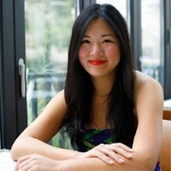
Meeting Minutes
June meeting minutes have been sent via WeChat

Slide 5
Agenda
Start | Time Allocated | Item | Speaker
8:15 | 5 minutes | Welcome & Attendance | Aaron and Elizabeth, Chairs
8:20 | 5 minutes | Update from Chairs | Aaron and Elizabeth
8:25 | 5 minutes | Comms & IT Updates | Elaine, Comms & IT Dir
8:30 | 5 minutes | Treasury Updates | Patrick, Treasurer
8:35 | 5 minutes | Legal Updates | Alex, Legal
8:40 | 5 minutes | Caucus Updates | Sarah
8:45 | 5 minutes | Shanghai Retreat | All
8:50 | 10 minutes | Open floor & Wrap up | Aaron, Chair presides

Slide 6
Update from the Chairs
Resolutions Meeting update
“Scorecard” feedback
July 4 events + emails
“Pledge to reg”

Slide 7
Upcoming Events
Second Primary Debate (August 1st and 2nd)
Book Club (Saturday, August 31):
"Looking Like the Enemy" by Mary Matsuda Gruenewald
September "Knock Down the House" Documentary Screening (Sept 21)
Barbecue/ Potluck October ?
DA Thanksgiving Dinner?
December Holiday Cocktail Party

Slide 8
Agenda
Start | Time Allocated | Item | Speaker
8:15 | 5 minutes | Welcome & Attendance | Aaron and Elizabeth, Chairs
8:20 | 5 minutes | Update from Chairs | Aaron and Elizabeth
8:25 | 5 minutes | Comms & IT Updates | Elaine, Comms & IT Dir
8:30 | 5 minutes | Treasury Updates | Patrick, Treasurer
8:35 | 5 minutes | Legal Updates | Alex, Legal
8:40 | 5 minutes | Caucus Updates | Sarah
8:45 | 5 minutes | Shanghai Retreat | All
8:50 | 10 minutes | Open floor & Wrap up | Aaron, Chair presides

Slide 9
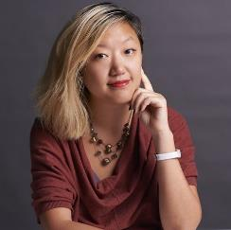
Comms & IT Updates
Updates:
Newsletter (second edition sent)
Interviews of volunteer + Board member

Slide 10
Agenda
Start | Time Allocated | Item | Speaker
8:15 | 5 minutes | Welcome & Attendance | Aaron and Elizabeth, Chairs
8:20 | 5 minutes | Update from Chairs | Aaron and Elizabeth
8:25 | 5 minutes | Comms & IT Updates | Elaine, Comms & IT Dir
8:30 | 5 minutes | Treasury Updates | Patrick, Treasurer
8:35 | 5 minutes | Legal Updates | Alex, Legal
8:40 | 5 minutes | Caucus Updates | Sarah
8:45 | 5 minutes | Shanghai Retreat | All
8:50 | 10 minutes | Open floor & Wrap up | Aaron, Chair presides

Slide 11
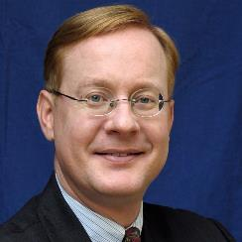
Treasury Updates
Updates:
Need to test donor info form
Need to test WeChat account (Chairs + Treasurer action)

Slide 12
Agenda
Start | Time Allocated | Item | Speaker
8:15 | 5 minutes | Welcome & Attendance | Aaron and Elizabeth, Chairs
8:20 | 5 minutes | Update from Chairs | Aaron and Elizabeth
8:25 | 5 minutes | Comms & IT Updates | Elaine, Comms & IT Dir
8:30 | 5 minutes | Treasury Updates | Patrick, Treasurer
8:35 | 5 minutes | Legal Updates | Alex, Legal
8:40 | 5 minutes | Caucus Updates | Sarah
8:45 | 5 minutes | Shanghai Retreat | All
8:50 | 10 minutes | Open floor & Wrap up | Aaron, Chair presides

Slide 13
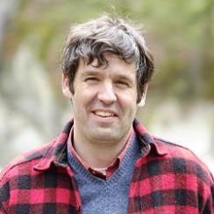
Legal Updates
Working on:
Chapters
Blockers:
Leadership Retreat

Slide 14
Agenda
Start | Time Allocated | Item | Speaker
8:15 | 5 minutes | Welcome & Attendance | Aaron and Elizabeth, Chairs
8:20 | 5 minutes | Update from Chairs | Aaron and Elizabeth
8:25 | 5 minutes | Comms & IT Updates | Elaine, Comms & IT Dir
8:30 | 5 minutes | Treasury Updates | Patrick, Treasurer
8:35 | 5 minutes | Legal Updates | Alex, Legal
8:40 | 5 minutes | Caucus Updates | Sarah
8:45 | 5 minutes | Shanghai Retreat | All
8:50 | 10 minutes | Open floor & Wrap up | Aaron, Chair presides

Slide 15
Caucus Updates
Updates:
Women’s Caucus leadership structure
Progressive Caucus resolution
Working on:
Progressive Caucus resolution

Slide 16
Agenda
Start | Time Allocated | Item | Speaker
8:15 | 5 minutes | Welcome & Attendance | Aaron and Elizabeth, Chairs
8:20 | 5 minutes | Update from Chairs | Aaron and Elizabeth
8:25 | 5 minutes | Comms & IT Updates | Elaine, Comms & IT Dir
8:30 | 5 minutes | Treasury Updates | Patrick, Treasurer
8:35 | 5 minutes | Legal Updates | Alex, Legal
8:40 | 5 minutes | Caucus Updates | Sarah
8:45 | 5 minutes | Shanghai Retreat | All
8:50 | 10 minutes | Open floor & Wrap up | Aaron, Chair presides

Slide 17
Shanghai Leadership Retreat
Agenda suggestions
Bylaws
Caucus buildout
Plan through 2020
Team building dinner
Drinks with SH volunteers

Slide 18
Agenda
Start | Time Allocated | Item | Speaker
8:15 | 5 minutes | Welcome & Attendance | Aaron and Elizabeth, Chairs
8:20 | 5 minutes | Update from Chairs | Aaron and Elizabeth
8:25 | 5 minutes | Comms & IT Updates | Elaine, Comms & IT Dir
8:30 | 5 minutes | Treasury Updates | Patrick, Treasurer
8:35 | 5 minutes | Legal Updates | Alex, Legal
8:40 | 5 minutes | Caucus Updates | Sarah
8:45 | 5 minutes | Shanghai Retreat | All
8:50 | 10 minutes | Open floor & Wrap up | Aaron, Chair presides

Slide 19
Open Floor

Slide 20
Wrap Up & Goodbye
Next meeting (August 24)

