Slide 1
HOW TO RUN A TAX EVENT
Notes:
People are lost about our tax issues, DA is a brand name people trust

Slide 2
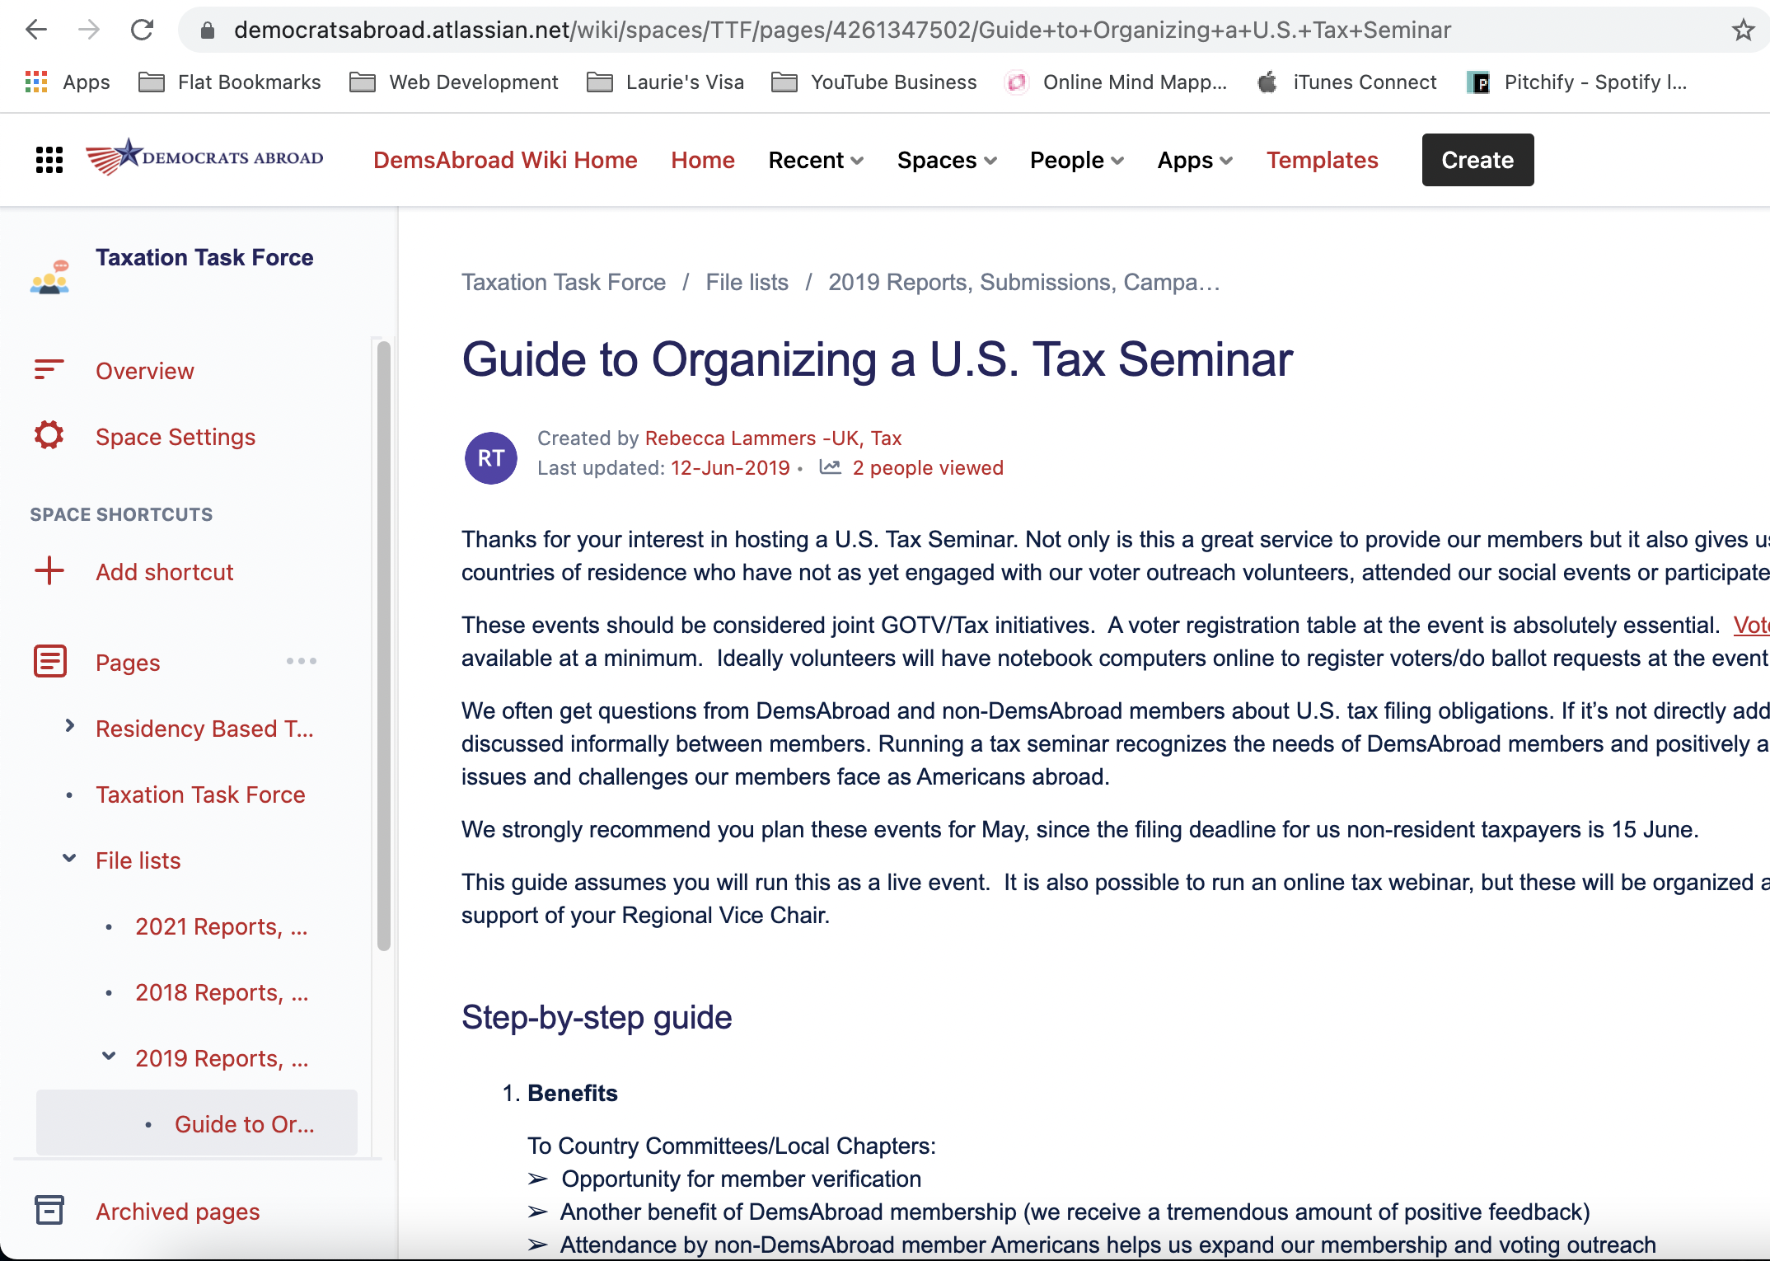
For More Info
Go to DA Wiki and search for “Guide to Organizing a U.S. Tax Seminar” for more info.

Slide 3
Why host a tax webinar?
It’s a service for our members
It brings in new members, always
It raises money
It emphasizes that voting and taxes have nothing to do with each other – so gets more people to vote!
It’s a trust building exercise
Notes:
People are lost about our tax issues, DA is a brand name people trust
Get DA members to help us help them

Slide 4
A tax webinar is not…
Giving people advice – we are providing information.
Telling people to file their taxes – this is for them to decide once they receive the information.
Scaring them into compliance – we are not Republicans! We can do better!
Notes:
There is a lot of wrong, bad and mis-information out there. DA is a brand name people trust, and we need to be responsible with that trust, so putting throught into the purpose of the webinar is really key before you get started.

Slide 5
How to start
Pick a date – at least a month ahead, but don’t be afraid to jump on doing a webinar that has to do with current news
Pick a topic
Pick you’re speaker(s)
Promote the date
Host the event
Send follow-up to attendees
Notes:
There is a lot of wrong, bad and mis-information out there. DA is a brand name people trust, and we need to be responsible with that trust, so putting throught into the purpose of the webinar is really key before you get started.

Slide 6
Webinar Topic Ideas
Expat Tax 101 & Getting Caught Up
Social Security
Savings, Pensions, and Investments
Retirement Planning
Financial Planning 101 (for younger people)
Financial Planning 201 (for older people)
Self-Employment
Tax Advocacy

Slide 7
Webinar vs In-Person
Webinar | In-Person
More people can participate from across the country | Helps people realize that they’re not alone in their struggles with taxes
More attendees means you can raise more money with no/little costs | In-person cost more because you have to pay for the venue
Gives people an outlet | More personal when in-person
Beware tax trolls! | People tend to not do silly things in person

Slide 8
Webinar Promotion Timeline
Task | Time
Announce event by email, social media, local expat facebook groups, Reddit | 2 weeks in advance
Send reminder email, post on social media, local expat facebook groups, Reddit | 1 week in advance
Reminder | 1 day before
Recording email, social media, local expat facebook groups, Reddit | The day after event

Slide 9
How much to charge?
$10 General or $5 retired/student – but you will know the best price points to charge for your CC
Use DA website to set up the event page
You should definitely charge, don’t be afraid to charge money. It’s a valuable service, there needs to be a value on it. Just try charging, if it doesn’t work, then you know what your price point is.
Exception – tax advocacy events should always be free unless in-person and there’s a venue cost.

Slide 10
Always record the event
Zoom recordings can be uploaded to the DA Official YouTube channel and shared unlisted or public (send to Rebecca or Karen Frankenstein)
66% of people can’t make the event date/time, recordings raise more donations and engage more DA members

Slide 11
How to find speakers?
Word of mouth recommendations
US accountants/investors attending other DAUK events
They contacted me asking to be a speaker
Ask other speakers if they had recommendations
Local American expat magazines/websites/Facebook groups/forums
Notes:
I started by asking a handful that I had been in touch with earlier in the year. There are a number of accountants and investors that come to the DAUK events/tax events regularly so they were easy to ask. Some people dropped out that I had to fill spots for last minute. Some emailed me directly and asked if they could participate when word spread about the event. For the spots that I was missing, I asked the speakers that had already agreed to speak if they had any recommendations and I filled the rest of the speaking slots from there. I had a phone call with each one beforehand to get a feel for how they spoke and to try to gauge if they would do a good job on the panels (just because they are a good accountant, doesn't mean they're a good speaker, unfortunately. The same viceversa.). I asked speakers I didn't know if they had participated in speaking engagements previously and if they have a video if they could send to me so I could view it to get a feel for their speaking style. Most of the financial advisors run their own events regularly so they knew how these things go. They all did it for free, I explained as a political organization we can't accept money from non-US companies which were good for them to have access to a room full of their target audience for free. Some of the speakers viewed speaking at the event as their community service for the year. Others were more salesly and were trying to get clients.

Slide 12
How to vet speakers?
Google them – make sure they have good reviews
See what people say about them on Twitter/Facebook.
Watch video recordings of them speaking at other events
Be weary of speakers approaching you!
If you want to do a webinar but you’re struggling, contact me and I can help Rebecca_Lammers@democratsabroad.org
Notes:
I started by asking a handful that I had been in touch with earlier in the year. There are a number of accountants and investors that come to the DAUK events/tax events regularly so they were easy to ask. Some people dropped out that I had to fill spots for last minute. Some emailed me directly and asked if they could participate when word spread about the event. For the spots that I was missing, I asked the speakers that had already agreed to speak if they had any recommendations and I filled the rest of the speaking slots from there. I had a phone call with each one beforehand to get a feel for how they spoke and to try to gauge if they would do a good job on the panels (just because they are a good accountant, doesn't mean they're a good speaker, unfortunately. The same viceversa.). I asked speakers I didn't know if they had participated in speaking engagements previously and if they have a video if they could send to me so I could view it to get a feel for their speaking style. Most of the financial advisors run their own events regularly so they knew how these things go. They all did it for free, I explained as a political organization we can't accept money from non-US companies which were good for them to have access to a room full of their target audience for free. Some of the speakers viewed speaking at the event as their community service for the year. Others were more salesly and were trying to get clients.

Slide 13
How to promote the event
Your CC Email Newsletter – send out in a dedicated email
Set up as event on website
Share on social media – Facebook and Twitter mostly
Post it on Reddit!
Contact local American expat magazines/websites/Facebook groups/forums

Slide 14
Commonly Asked Questions from DA Leaders
Notes:
People are lost about our tax issues, DA is a brand name people trust

Slide 15
“DA can’t give tax advice, what do I do?”
This is why we have a disclaimer! Yes, read it out loud and include on emails
Disclaimer: Democrats Abroad cannot provide individual tax advice. Advice requires consideration of your individual circumstances and needs, none of which can be done at this event. We are not tax lawyers, accountants, or advisers. Please consult a professional tax adviser/accountant/return preparer when addressing your personal tax matters.
Democrats Abroad does not endorse or recommend companies or individuals attending or hosting this event. The views expressed at the event are those of the respective individuals and companies, not Democrats Abroad. No liability is accepted by Democrats Abroad for the opinions expressed, or for any errors or omissions expressed about matters of tax in any country, your financial planning, or your legal obligations.
If you are in need of tax advice you can consult the IRS Tax Return Preparer Directory to find an advisor or tax return preparer near you or providing online services to meet your needs and budget, though buyers need always beware: https://irs.treasury.gov/rpo/rpo.jsf
Notes:
This cover us legally that we are not providing advice, It should go on all your marketing material and to read it out loud at the beginning of the event itself. It’s important to re-iterate we are not accountants and we are a political party and we can’t give any recommendations or advice.
That said, if you do enough of these tax webinars, you could put up a list of “past speakers” – or point people to the ACA directory.

Slide 16
“We can’t charge, we struggle to get DA members to come to our events”
DA and non-DA members attend tax events because they can’t get the info anywhere else.
Tax events appeal to DA members who don’t usually attend DA political events. They will come.
Just try charging, see what happens! If it doesn’t work, then you know!
Unless there are banking regulations in your country for making online card payments in USD, you should charge. Exceptions are China, some countries in South America, etc.

Slide 17
“Someone else is hosting a tax event around the time we want to host, I don’t want to overlap with their event”
Tax season is traditionally Feb-April, there are usually a lot of tax events this time of year. This isn’t overlap, this is normal.
People will want to go to both events, there’s not a conflict.
DA members are a different audience vs the audience other orgs will have.

Slide 18
“Why host a local tax event when global is hosting tax events?”
Global events can’t address cross-border issues specific to taxes in your country of residence.
People like to learn in smaller groups with people that are living in the same country.
Global will only cover topics that apply to all DA members, not cross-border.
Local events engage DA members in local Country Committees/Chapters – maybe you’ll pick up new volunteers or members?!

Slide 19
Global Topics vs Country Specific Topics
Global Topics | Country Specific Topics
How to Survive Tax Day | US/Country specific tax
How to File the FBAR | Financial Planning – Savings, investments
Investing as an American Abroad | Retirement Planning - Pensions
State Taxes & Voting | Self-Employment
Tax Advocacy | Tax for dual citizens

Slide 20
“Global is scooping up all the money”
With tax events, people are “repeat customers”
Recent global event raised most donations from DA members who didn’t attend an event in 2022
This stuff is hard, people come back every year
We’ve not hit a maximum on donations or “critical mass” on tax events. Let’s make a good problem happen!
People really appreciate options, and don’t see everything

Slide 21
Other “Service” Based Event Ideas
Social Security
Medicare
How to register a birth abroad
Taxpayer Advocate Service
Taxpayer Advocacy Panel
Invite your local Embassy or Consulate to speak
2023 is the perfect year to build trust within your local American community!

Slide 22
Should you allow participants to ask specific questions about their own situation?
Ask attendees to pre-submit questions in advance
Helps avoid people sharing personal information in a room full of strangers
Helps saves them the embarrassment of asking personal/embarrassing questions
Helps to avoid repeating information and to cover more info in the session

Slide 23
What is the main political message of the event?
#1 Vote
#2 Contact your members of congress to raise awareness of the tax discrimination you personally face as an American abroad

Slide 24
Always do a feedback form!
Online form or hand out 1 page feedback form to get feedback.
Helps improve for next time, and really rewarding to read positive comments!

Slide 25
Quote from recent tax webinar:
"You said taxes are a dry and boring topic, if only they were just that and not the painful and stress inducing topic that we actually experience! Addressing the situation and talking openly to other expats about it without fear could go a long way toward coming together as a force to be reckoned with back in the states!"
Notes:
People are lost about our tax issues, DA is a brand name people trust
Get DA members to help us help them

Slide 26
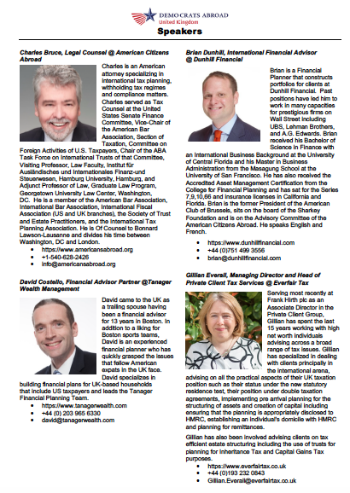
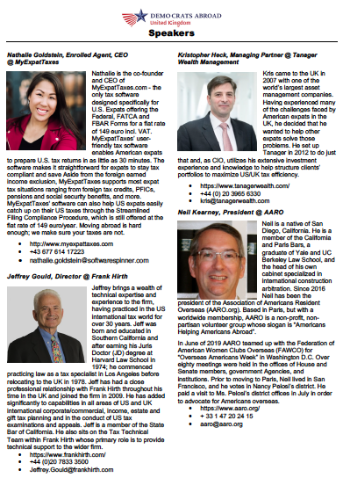
Can you distribute panelist contact information or let them give out business cards?
Notes:
Did you distribute panelist contact information?
Yes, you can see how I did it in the event program attached. I decided to provide contact details because of what happened after last year's event. I got about at least a dozen emails from people asking "can you give me contact details for x speaker?" and I told them to google it, and then they complained they still couldn't find them so... I was concerned about "recommending" the speakers, but on the event program it has a very clear disclaimer saying we're not recommended any of the speakers so we're at least covered legally in that respect.
Did panelists give out business cards?
Not everyone. We had a table that any of the speakers could leave business cards/brochures etc on in front of the main stage. That's the location that we encouraged people to go to after a panel finished if they wanted to ask one-to-one questions.

Slide 27
If you do in-person
Have food & drink!
Have a voter reg table
Allow attendees to go up to and speak to speakers one-to-one after the session
Allow people to mingle after, it helps them socialize and feel more connected to the DA community
Get pictures and post them on social media!

Slide 28
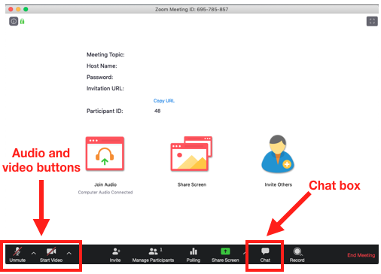
If you do online
Consider using the global zoom account as a webinar (not meeting!) so that you can use the Q&A function, since the chat box can get busy.
If you do a zoom meeting, remind people to mute themselves and turn off their video.
Spotlight the speakers.
Keep the chat box open, but have good moderators in place to keep anyone from high jacking the event – paid for events will not usually have trolls

Slide 29
Tips & Tricks
Start selling tickets early, you can meet deadlines to promote the event and get into a few American expat magazines, websites, newsletters and Facebook groups
Video the sessions and sell them afterwards to make extra $£€
Asking people to join the mailing list who said they couldn’t attend for next time
Always have feedback forms

Slide 30
Tips & Tricks Continued
In-person events are great if you have a big population in one city, but a lot of work
If you’re going to only do 1 tax webinar, do it as early in the year as possible. This is when people are thinking about doing their annual tax return!
You can run webinars anytime of year, but during tax season (Feb-May) is best.
If presenters are doing slides, ask them to send you the slides in advance and send the slides to attendees in advance too.
Educate everyone involved on how to communicate about the event. Eg. Do not call it a workshop, advice, etc.

Slide 31
Results
Tax events are some of the most well attended DA events, be ready for volume!
Big events can raise over $1,000 when done right
Every time you host an event, it really helps raise awareness of DA’s tax advocacy efforts – so thank you!

Slide 32
THANK YOU!
Email for questions/help hosting a webinar:
rebecca_Lammers@democratsabroad.org

